Slide 1
Geant4 Basics
Brian Mong - Laurentian University
2015 PAG Computer Day

Slide 2
Why do we use Geant4
Often experimental data does not perfectly categorize into signal and noise (background)
Monte Carlo is used to predict the signal shapes of backgrounds and signals
These form a set of PDFs (probability density functions) that are fit to the data
Example next slide
Sometimes you want to predict the performance of a detector before it is built

Slide 3
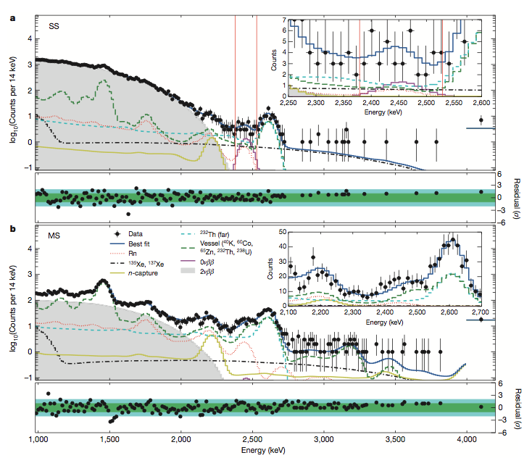
EXO-200 neutrinoless double beta decay search

Slide 4
So what is Geant4?
Basically a set of C++ libraries that help
Setup experiment/detector geometry
solids / materials / fields
Define physics processes
Must select physics that is important in experiment
Generate particles
Radioactive decays, particle beams, etc
Propagate/track particles in experiment
uses physics process that were defined
Output hits / energy deposits / etc
Visualize particle tracks and geometry

Slide 5
And Now What?
Since Geant4 is basically only a set of libraries each usage case is different
In EXO-200: Geant4 is only one module in our simulations/reconstruction code.
MC hits are fed into a signal generator
These signals are reconstructed the same way our data is reconstructed
The whole framework is written in C++
There is no standard implementation but Geant4 does come with many examples…

